Slide 1
Digital Portfolio
STUDENT NAME: MEGA PRIYA THARSHINI M
REGISTER NO AND NMID: 2428C0485 &
9C4695C6D38E8AC8F434E6BE0B4C6D8C
DEPARTMENT: B.Sc - AIML
COLLEGE: KPR COLLEGE/ BHARATHIYAR UNIVERSITY

Slide 2
PROJECT TITLE
Personal and Psychologist Portfolio Website.

Slide 3


AGENDA
Problem Statement
Project Overview
End Users
Tools and Technologies
Portfolio design and Layout
Features and Functionality
Results and Screenshots
Conclusion
Github Link
3/21/2024 Annual Review

Slide 4

PROBLEM STATEMENT
Problem Statement Many psychologists and counseling students do not have a proper portfolio to present their skills and practical experience. A normal resume cannot fully show important aspects like counseling methods, case studies, research work, or community activities. In today’s digital era, a resume alone is not enough to highlight the creativity, empathy, and professional skills of a psychologist.

Slide 5

PROJECT OVERVIEW
Showcases psychologist’s background, qualifications, and expertise. Highlights therapeutic approaches, areas of specialization, and services offered. Builds trust with certifications, testimonials, and professional achievements. Provides easy appointment booking and secure contact options. Acts as a professional brand identity and a client-friendly platform. Makes psychological support accessible, understandable, and reliable.

Slide 6

WHO ARE THE END USERS?
Psychology Students – using portfolios for internships, training, and academic projects.
Job Seekers in Psychology – presenting skills and practical experience to recruiters.
Counselors & Therapists – showcasing counseling methods, case studies, and client work.
Researchers – highlighting published work, studies, and conferences.
Mental Health Professionals – demonstrating experience, workshops, and community programs.

Slide 7

TOOLS AND TECHNIQUES
HTML CSS JavaScript GitHub VS Code

Slide 8
POTFOLIO DESIGN AND LAYOUT
Home / About me Project Skills Contact Responsive layout [mobile and desktop view]
8

Slide 9
FEATURES AND FUNCTIONALITY
Navigation Bar with Smooth Scroll – easy access to About, Skills, Experience, and Contact. Case Studies & Research Display – showcase counseling approaches, research work, and findings. Therapy Methods Section – highlight techniques (CBT, mindfulness, group therapy, etc.). Workshops & Community Activities – space to present seminars, awareness programs, and outreach work. Contact Form – for clients, students, or recruiters to connect easily. Responsive Design – works well on all devices.

Slide 10
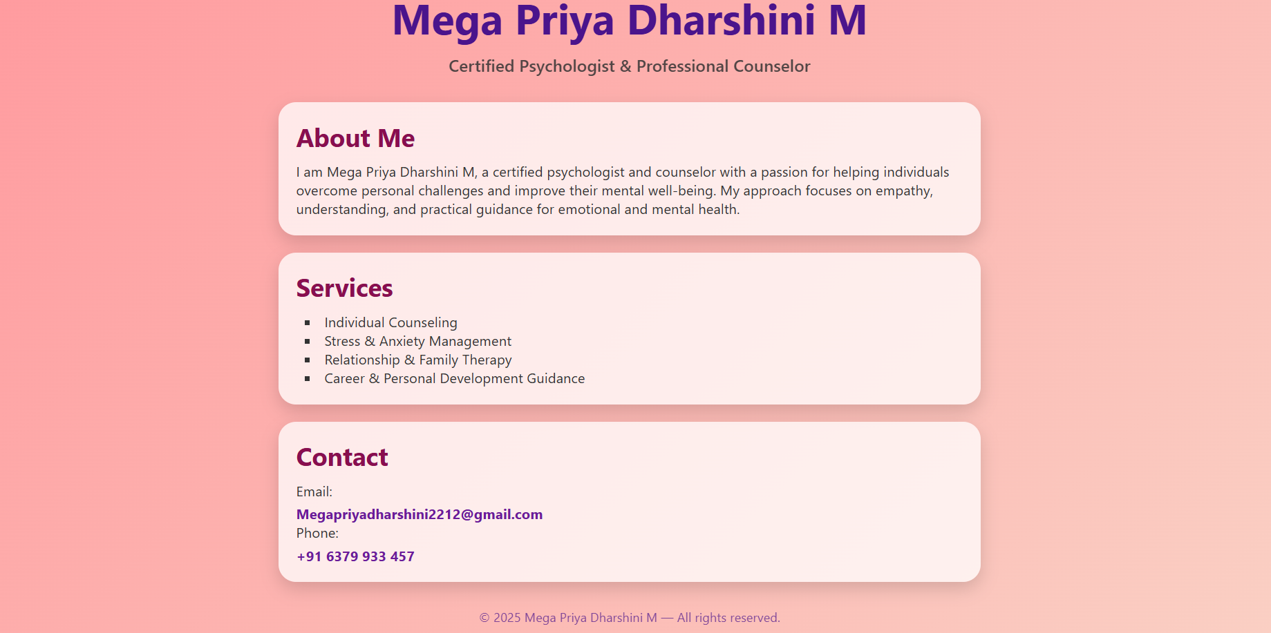

RESULTS AND SCREENSHOTS
3/21/2024 Annual Review
10

Slide 11
GITHUB LINK
https://github.com/megapriyadharshini

Slide 12
CONCLUSION
Showcases my skills and therapeutic approaches Summarizes my clinical experience, research, and contributions Helps others understand my professional abilities and counseling style Makes it easier for recruiters, clients, and institutions to connect with me
12

